Slide 1
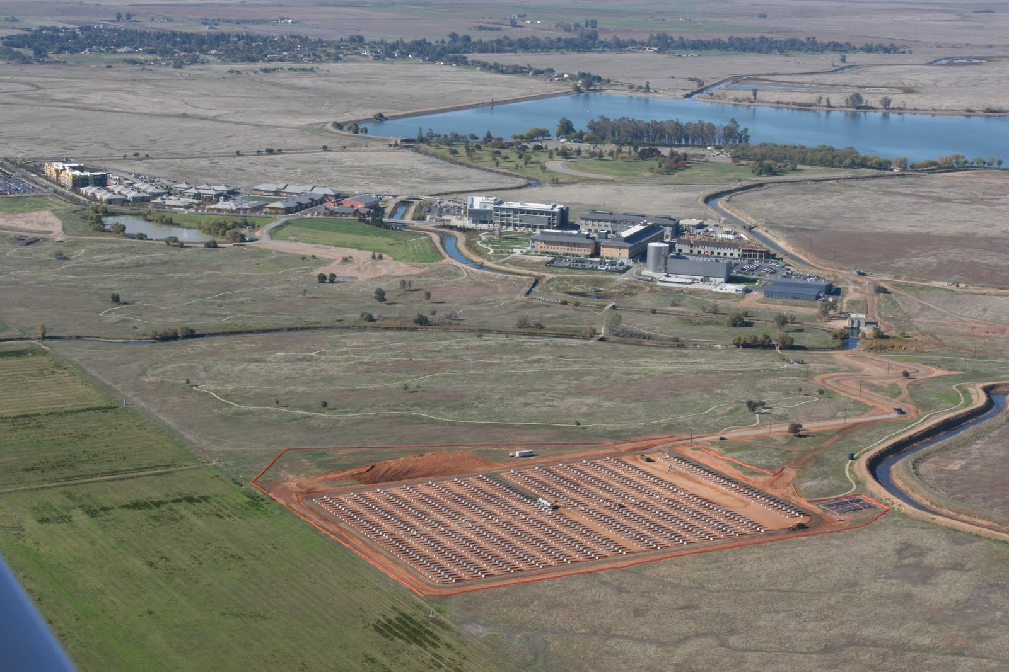
Solar RFP Pre-bid
Informational Session
  The newest 10th campus of the UC system
  Established 2005
  Currently about 6,300 students enrolled
  Projected to grow to 10,000 students by 2020

Slide 2

UC Merced is Committed to achieve the following sustainability goals by 2020:
Zero Net Energy
  Net energy through efficiency and renewable energy production.
Zero Landfill Waste
  Divert from landfill all campus waste by reducing excess consumption and recycling to the maximum extent feasible
Zero Net Greenhouse Gas Emissions
  Prevent as much carbon emissions as it produces.

Slide 3
Project 2020
Campus goal to reach 10,000 by 2020
Strategy: Utilize all available funding sources including private partnerships
P3: Private Public Partnership
  Partnership with a private developers to meet campus growth targets
http://2020project.ucmerced.edu/

Slide 4
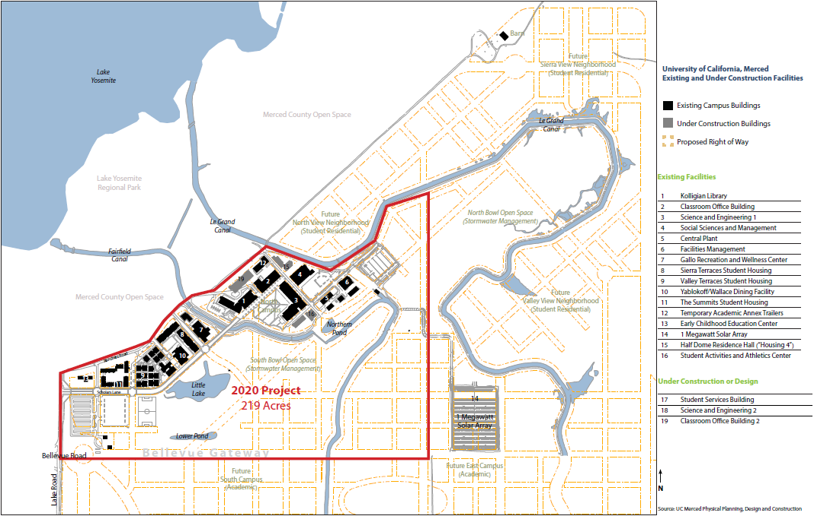
Project 2020 Site

Slide 5
Projected Energy Consumption

Slide 6
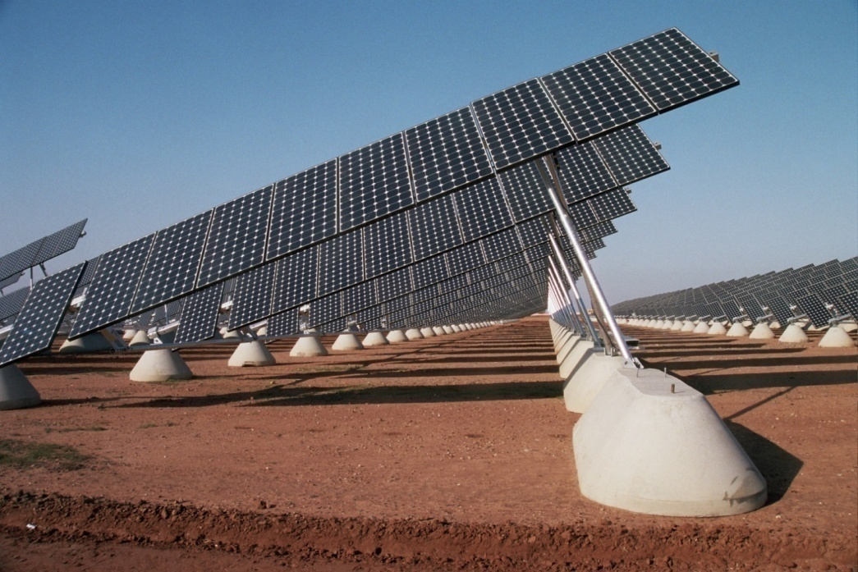
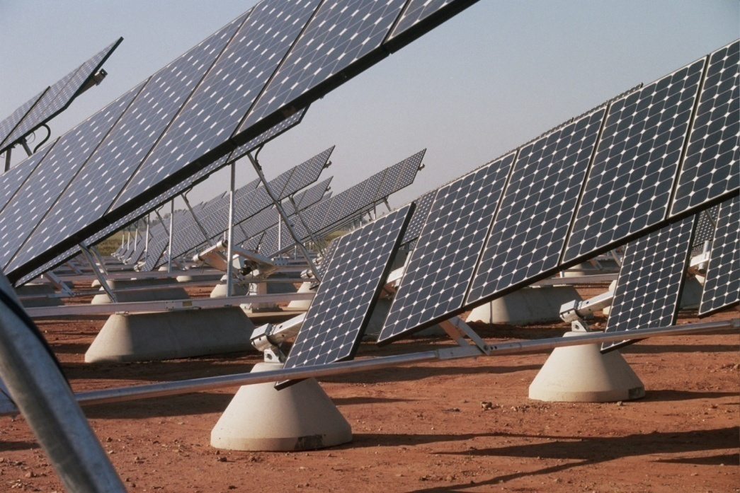
8.5 acre site
4,900 solar panels
Current produces 14-15% of campus energy
Zuhair Mased zmased@ucmerced.edu

Slide 7
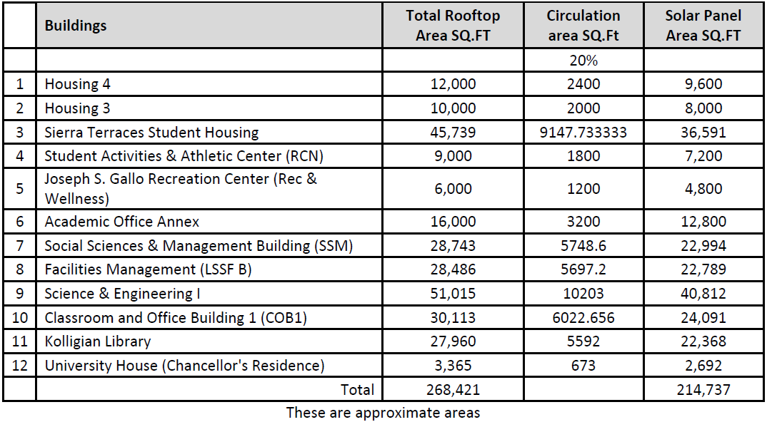
Rooftop Solar RFP

Slide 8
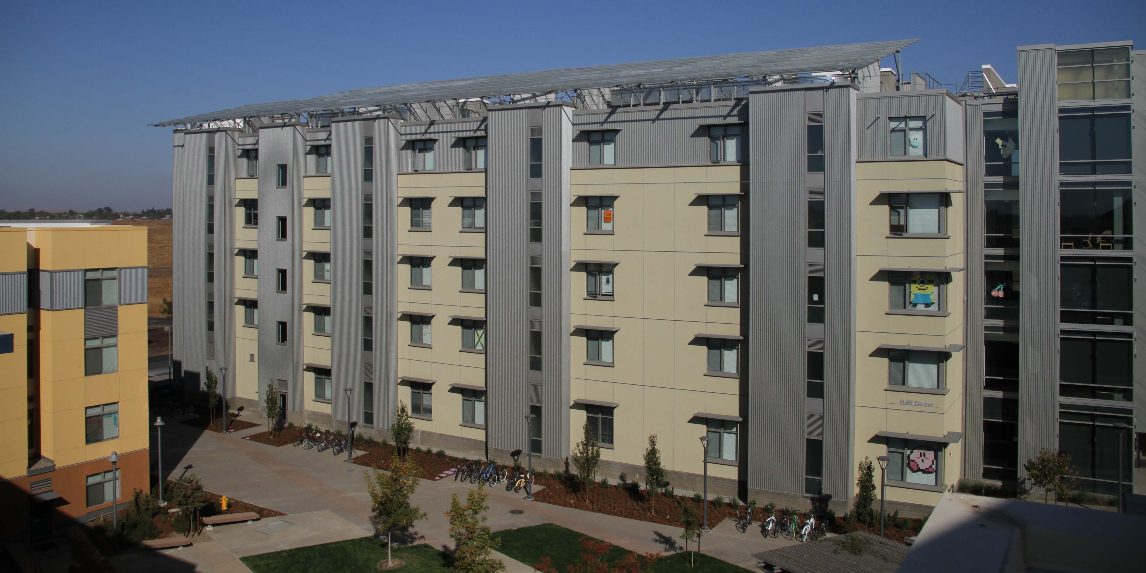
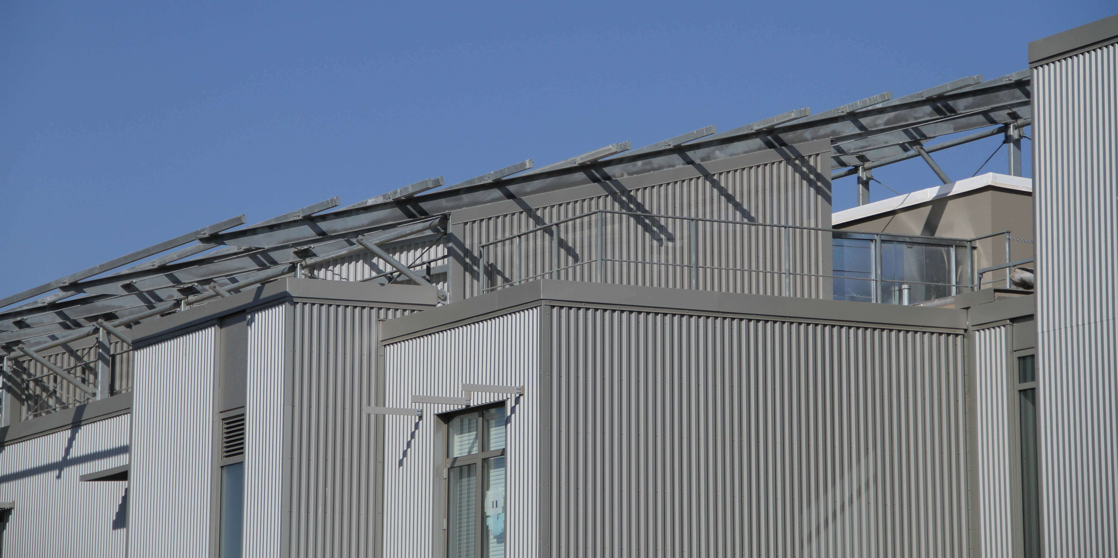
Housing 4 (Half Dome)

Slide 9
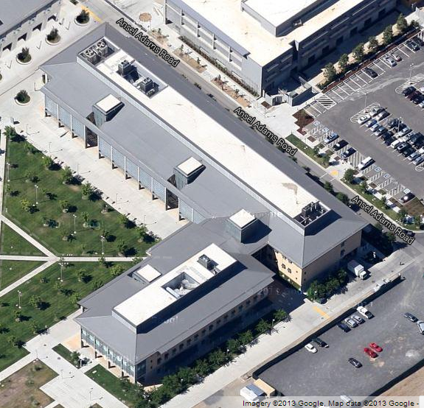
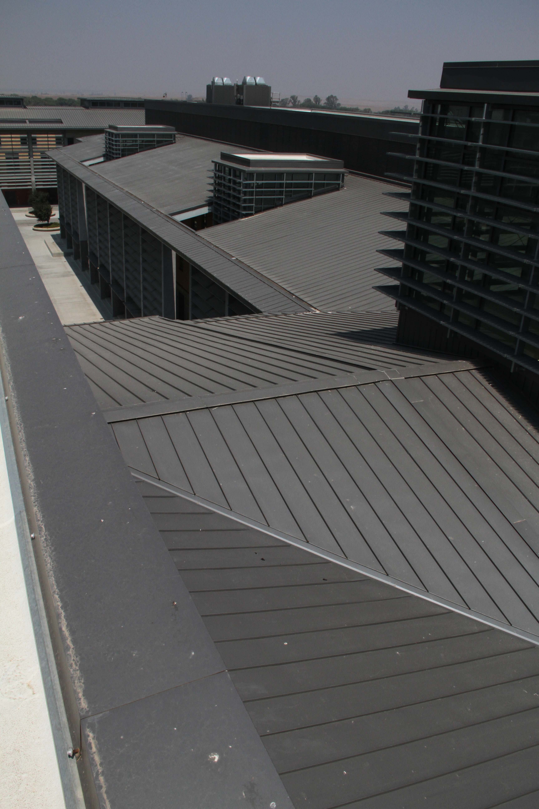
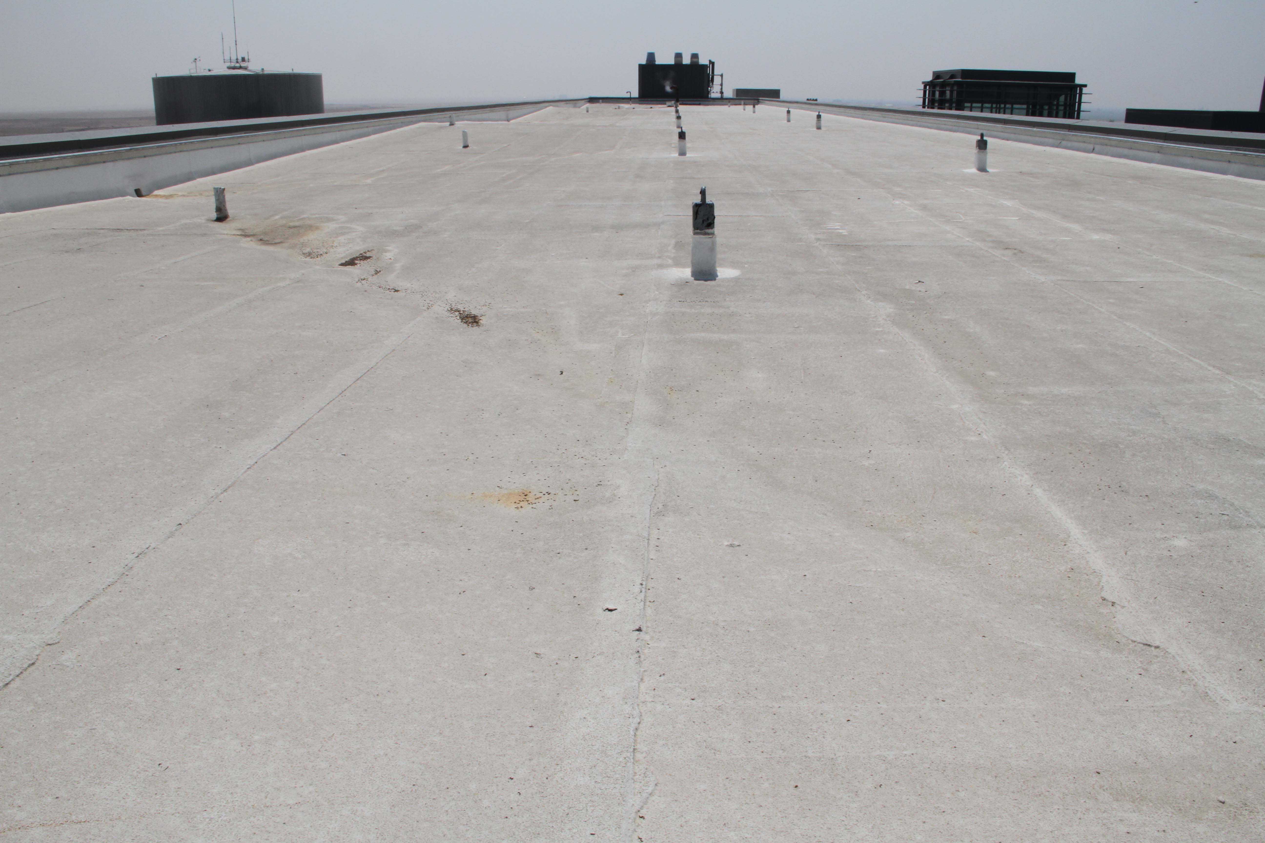
Science and Engineering 1 (SE1)

Slide 10
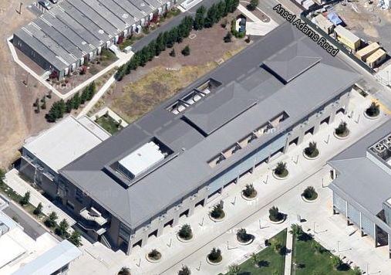
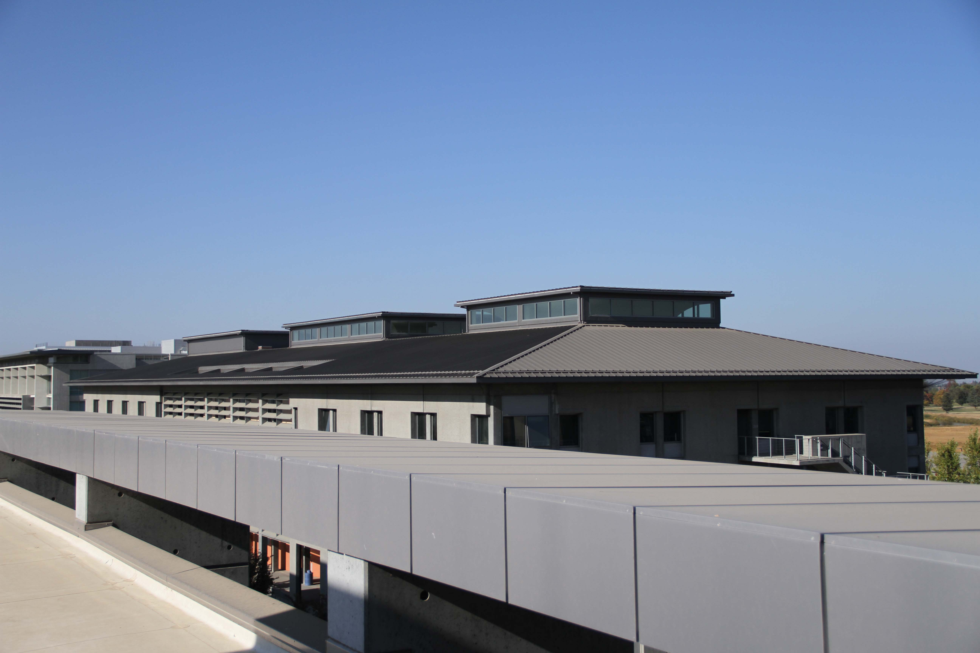
Classroom and Office Building (COB)

Slide 11
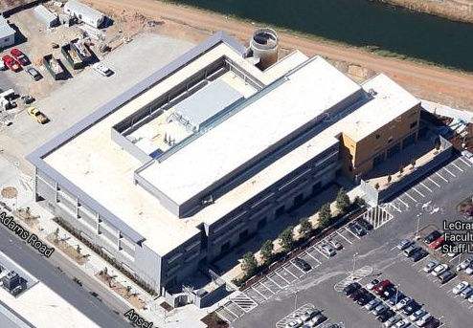
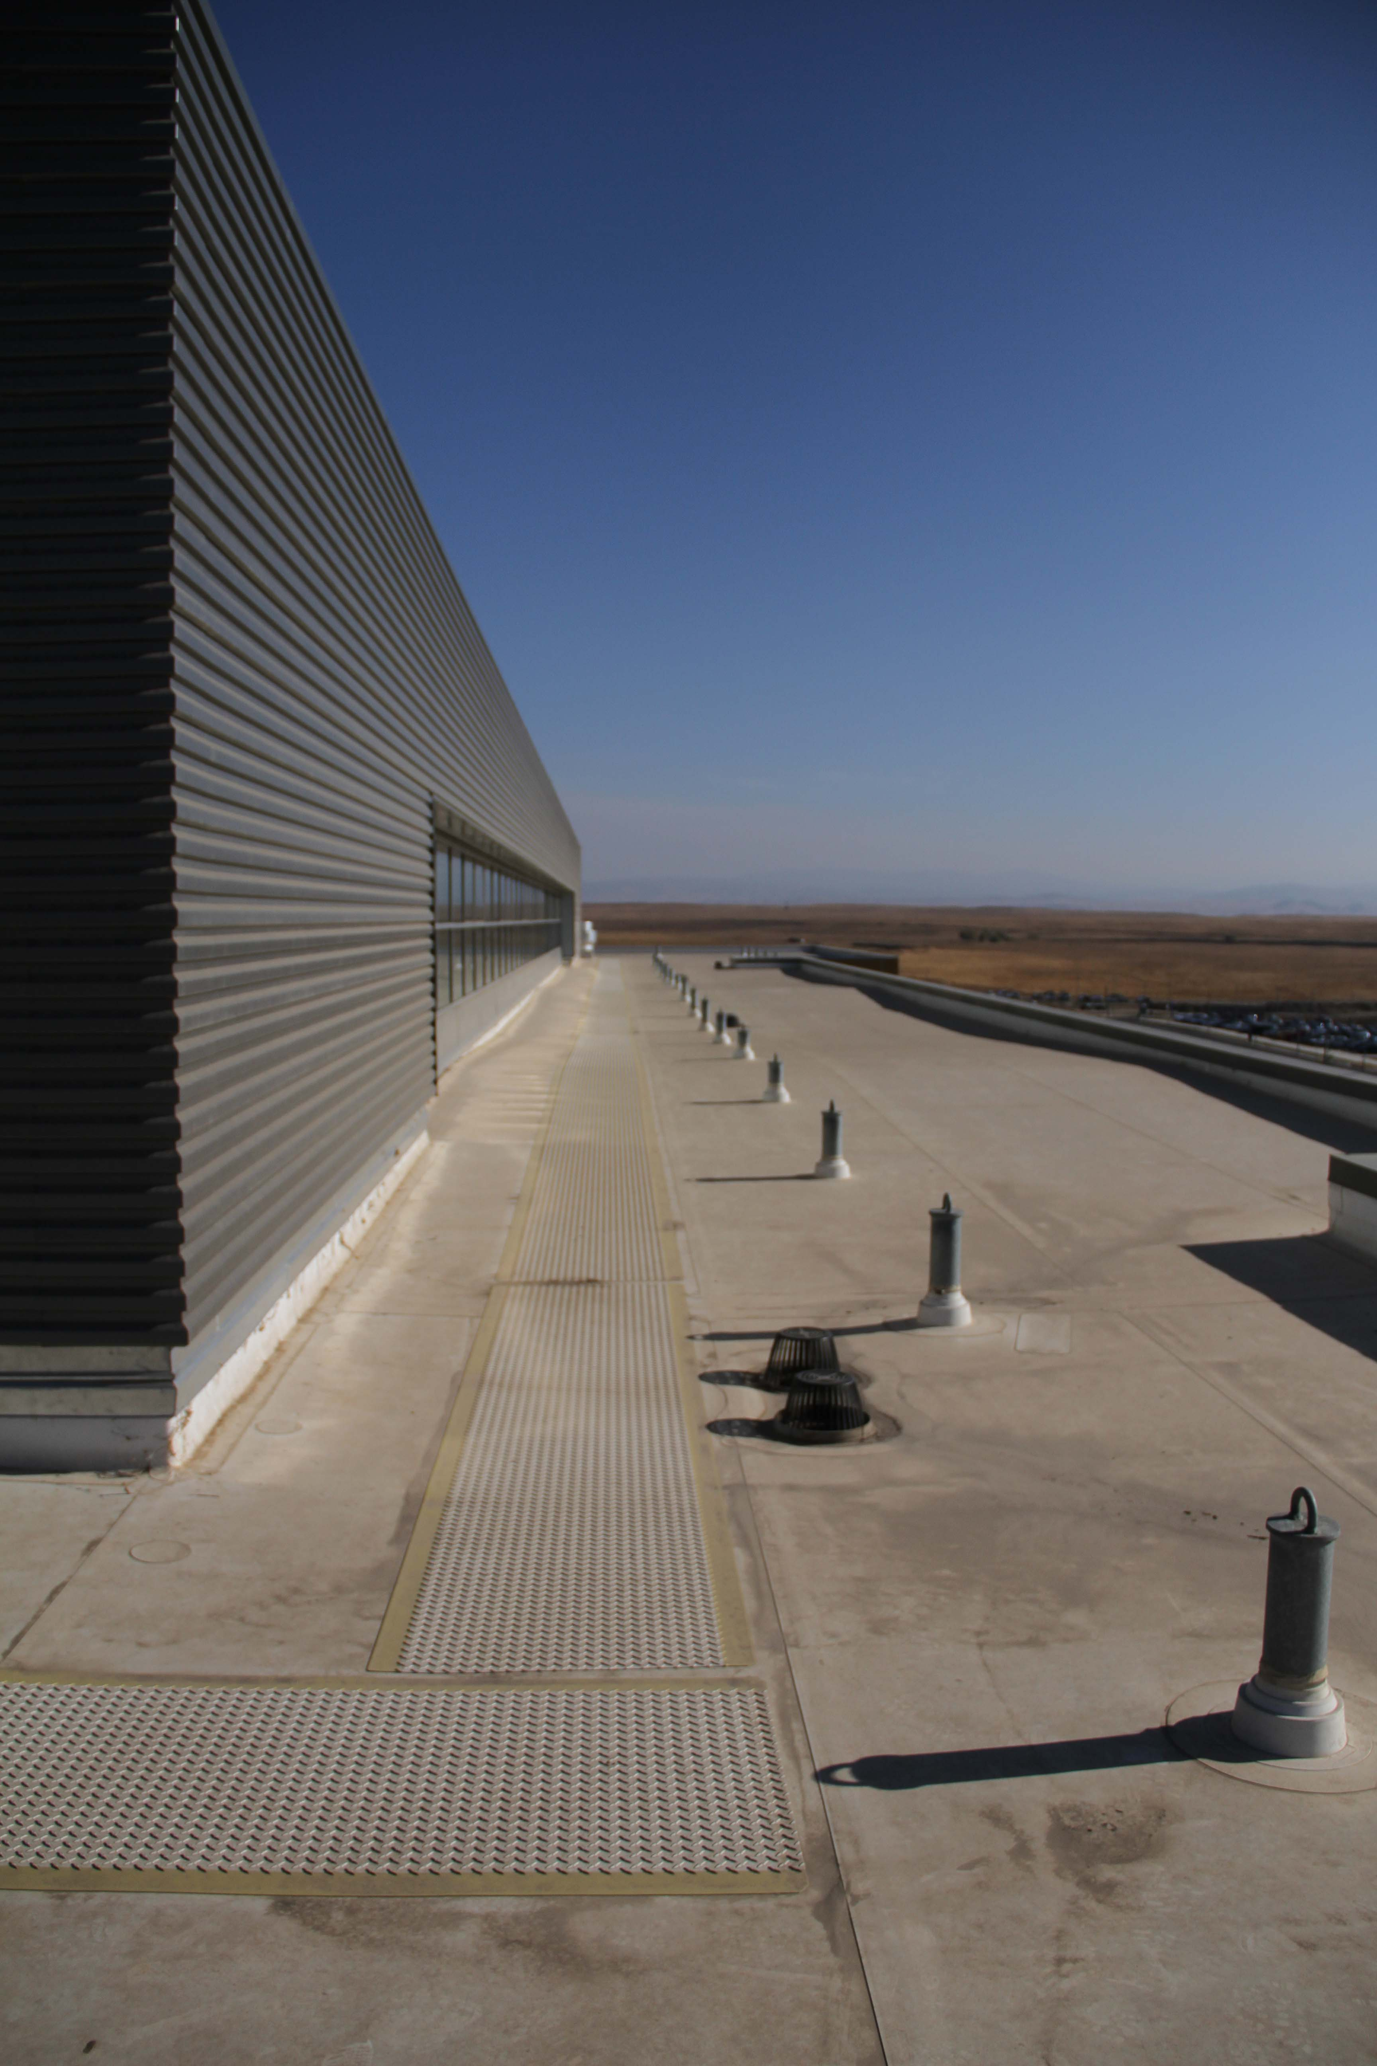
Social Science and Management (SSM)

Slide 12
Rooftop Solar RFP
Questions?

